Slide 1
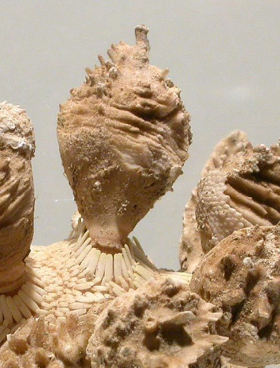
Understanding morphometrics of cidaroid echinoid spines
Jerrad Watts
Schultz, 2006

Slide 2
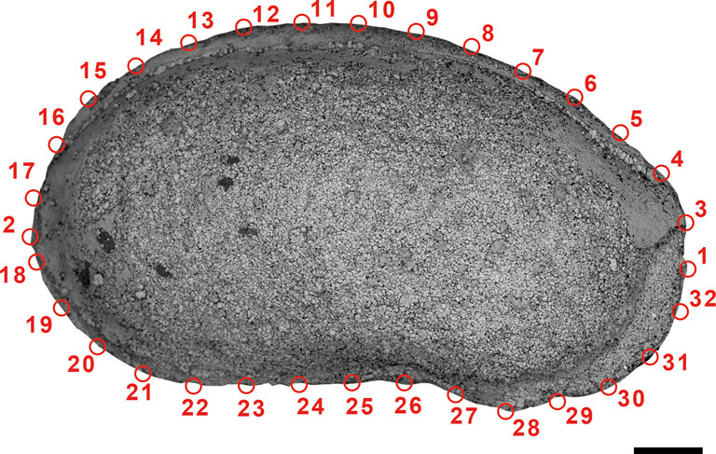
Methods
Outline analysis
- 2D Landmark-based geometric morphometrics
Capture gross morphology & ornamentation
Wan et al., 2021

Slide 3
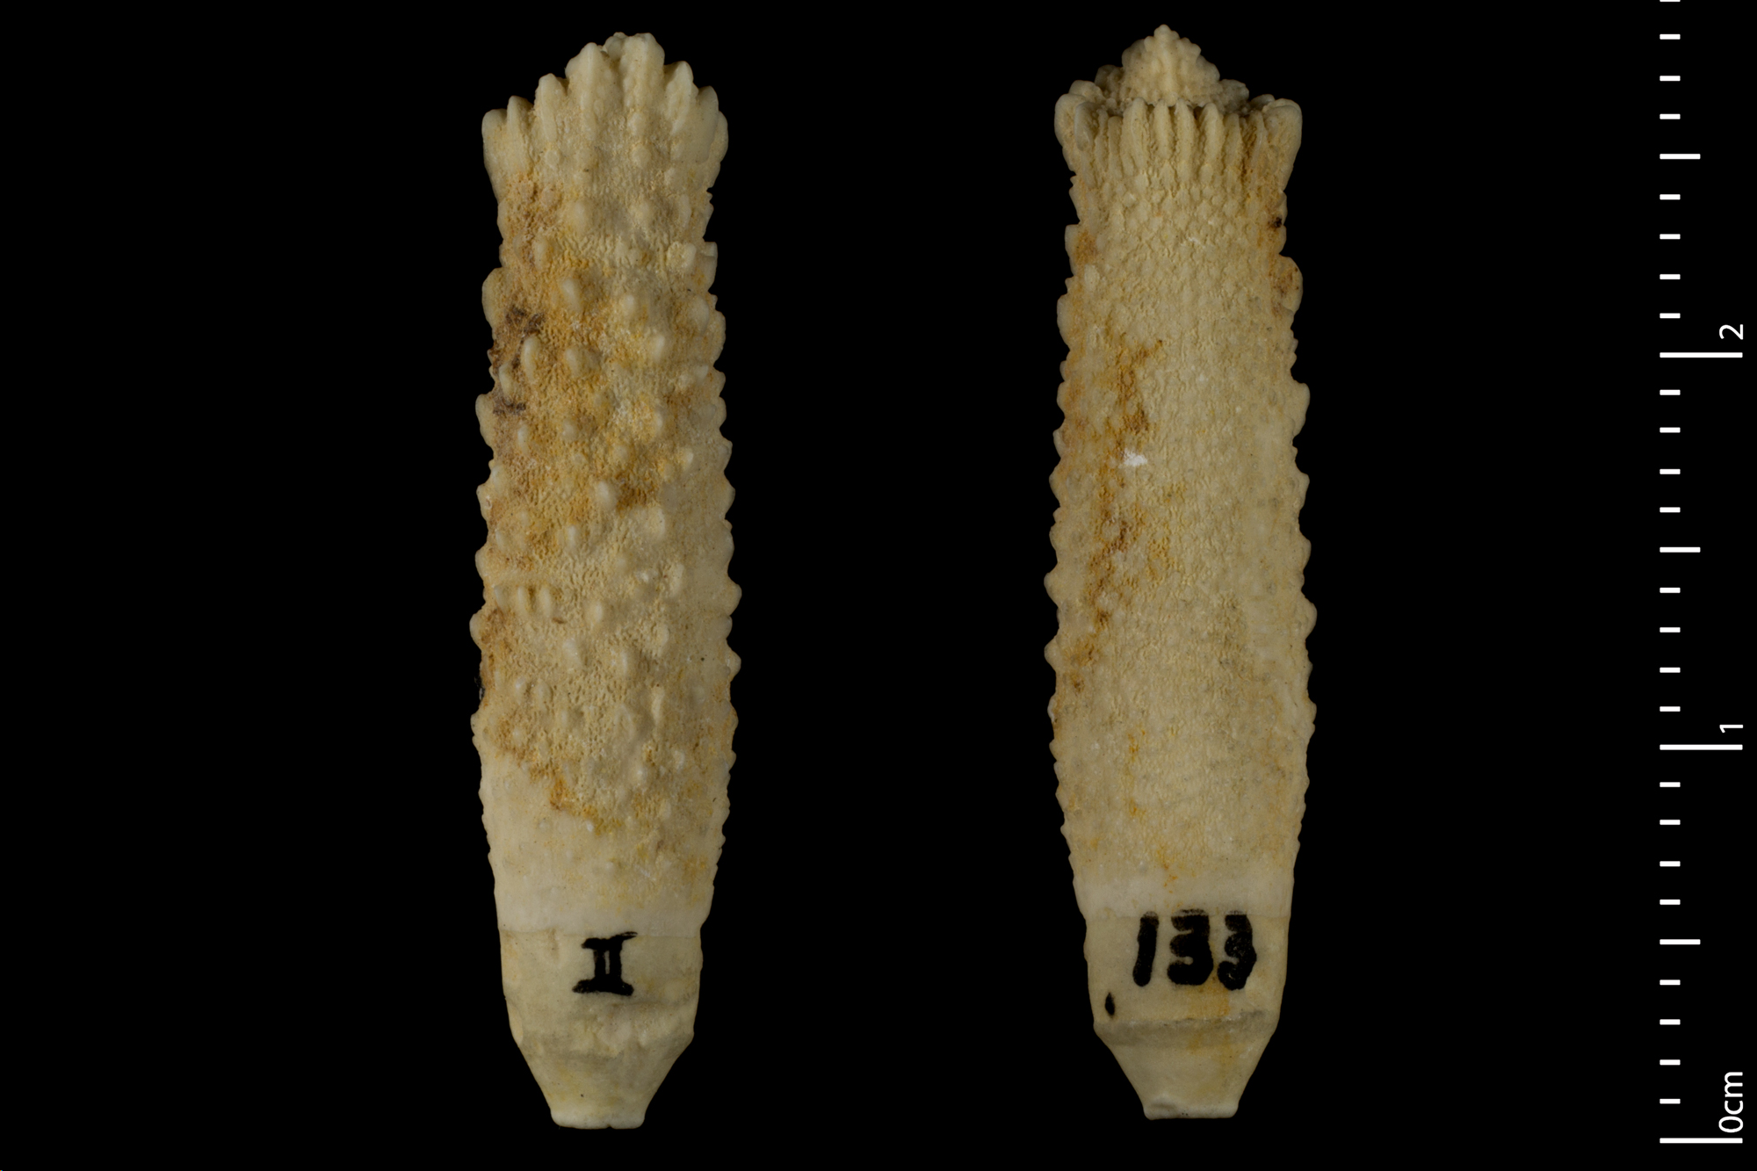
Spine morphology
Goniocidaris noetlingi
Shaft with ornamentation
Gross morphology
Ornamentation
Tip
Collar & ring
MNHN, Chagnoux, 2024

Slide 4
Outline Methods
Goniocidaris noetlingi
Landmarks
ImageJ to create outlines
4 landmarks
- Homologous points
Varying semilandmarks amounts
Semilandmarks
MNHN, Chagnoux, 2024

Slide 5
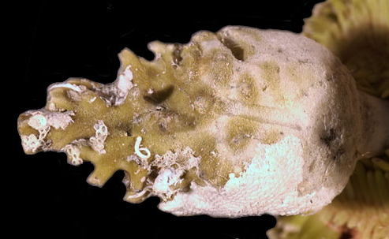
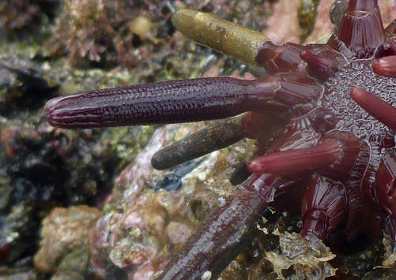
Data
Tylocidaris ohshimai
22 specimens across 3 genera
Phyllacanthus
Tylocidaris
Goniocidaris
MCZ Harvard
Phyllacanthus parvispinus
Goniocidaris noetlingi
MNHN, Chagnoux, 2024
Robin Gwen Agarwal, iNaturalist

Slide 6
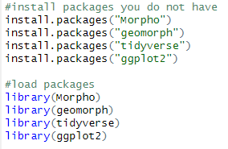
Packages
Focusing on geomorph
-Just touching upon Morpho

Slide 7
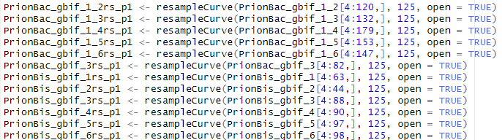
Morpho: resampling curve
resampleCurve(data[between which coordinates],
number of new points you want,
open or closed curve)

Slide 8
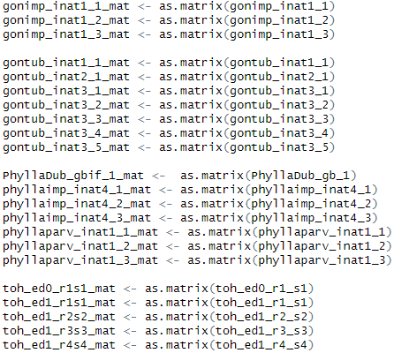
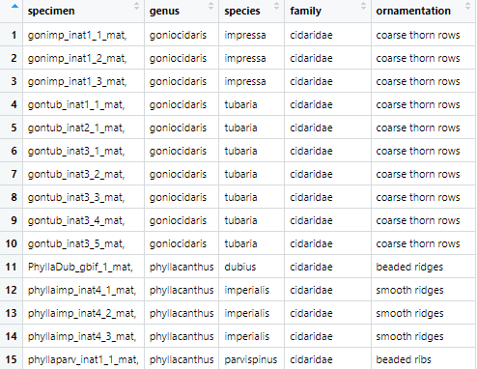
Data wrangling
Reformat after upload

Slide 9
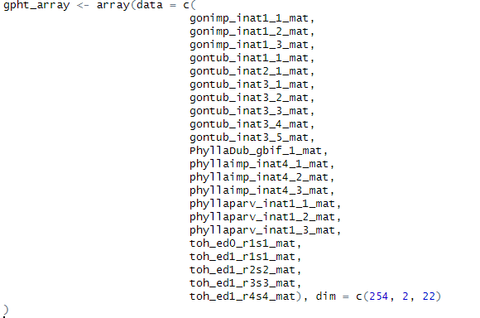
Array
Dim
Number of rows
Number or columns
Number of data sets

Slide 10
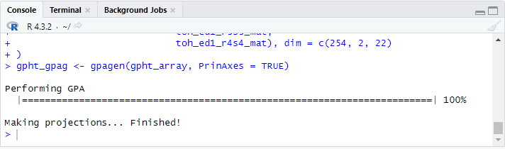
geomorph: Procrustes Analysis

Slide 11
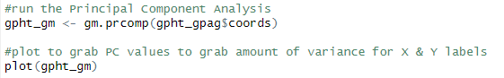
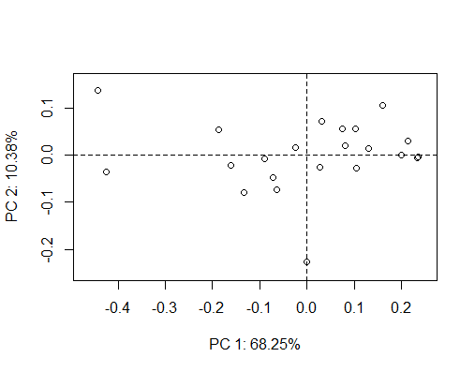
geomorph: Principal Component Analysis & basic plot

Slide 12
geomorph: Principal Component Analysis & basic plot
Final graph labels

Slide 13
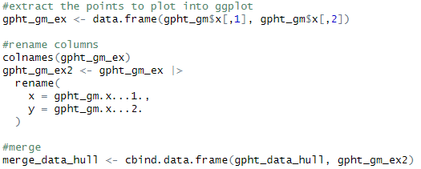
Extract & merge with species data

Slide 14
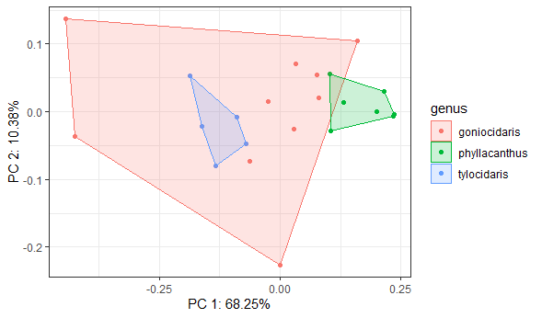
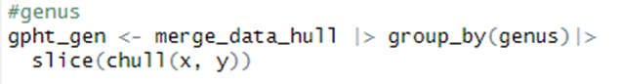
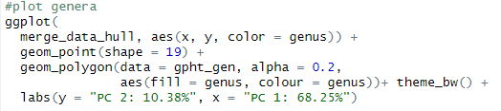
Results: plot by genera

Slide 15
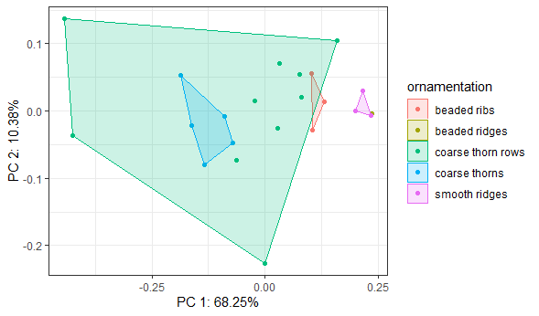
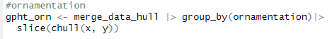
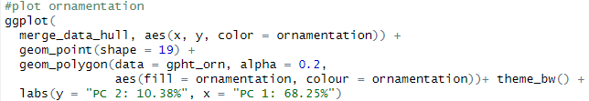
Results: plot by ornamentation

Slide 16
References
Baken E, Collyer M, Kaliontzopoulou A, Adams D (2021). “geomorph v4.0 and gmShiny: enhanced
analytics and a new graphical interface for a comprehensive morphometric experience.”
Methods in Ecology and Evolution, 12, 2355-2363.
Caton, N. R., Pearson, S. G., & Dixson, B. J. (2022). Is facial structure an honest cue to real-world dominance and
fighting ability in men? A pre-registered direct replication of. Evolution and Human Behavior, 43(4), 314-324.
Kroh, A., & Smith, A. B. (2010). The phylogeny and classification of post-Palaeozoic echinoids. Journal of systematic Palaeontology, 8(2), 147-212.
R Core Team. 2024. R: A Language and Environment for Statistical Computing. from https://www.r-
project.org/
Thulman, D. K., Shott, M. J., Slade, A. M., & Williams, J. P.. 2023. Clovis point allometry, modularity,
and integration: Exploring shape variation due to tool use with landmark-based geometric
morphometrics. Plos one, 18(8), e0289489.
Wan, J., Foster, W. J., Tian, L., Stubbs, T. L., Benton, M. J., Qiu, X., & Yuan, A.. 2021. Decoupling of
morphological disparity and taxonomic diversity during the end-Permian mass extinction.
Paleobiology, 47(3), 402-417.
Xue, C., Yuan, D. X., Chen, Y., Stubbs, T. L., Zhao, Y., & Zhang, Z. (2024). Morphological innovation
after mass extinction events in Permian and Early Triassic conodonts based on
Polygnathacea. Palaeogeography, Palaeoclimatology, Palaeoecology, 112149.

Slide 17
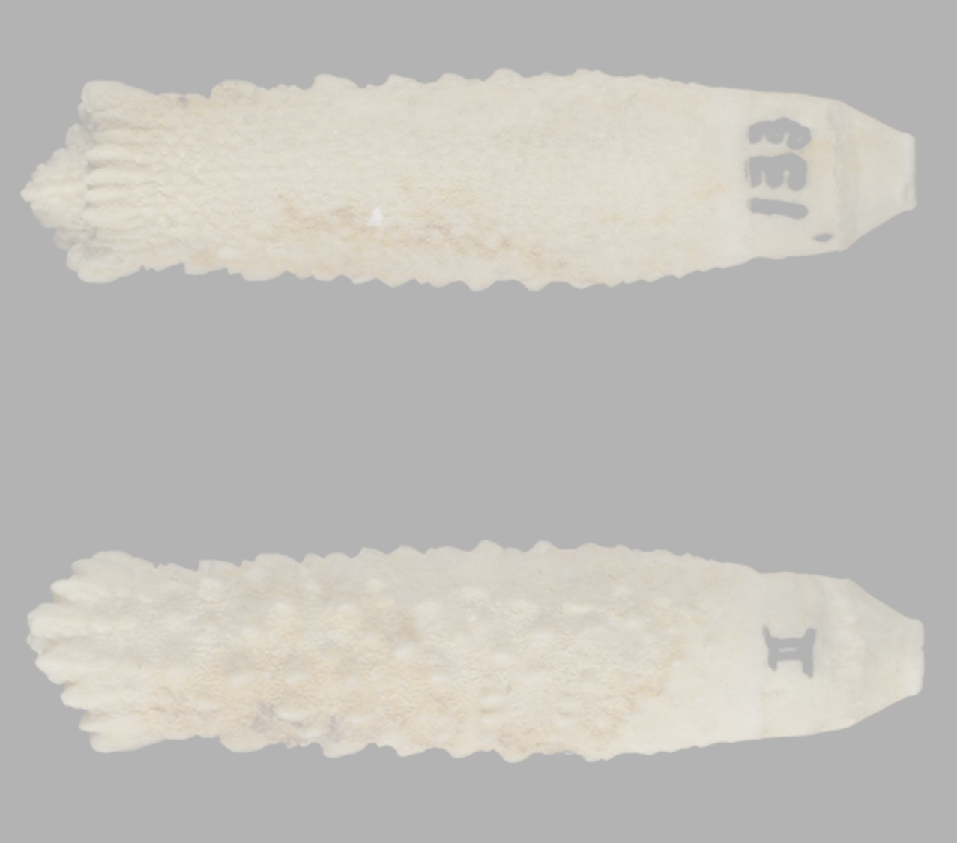
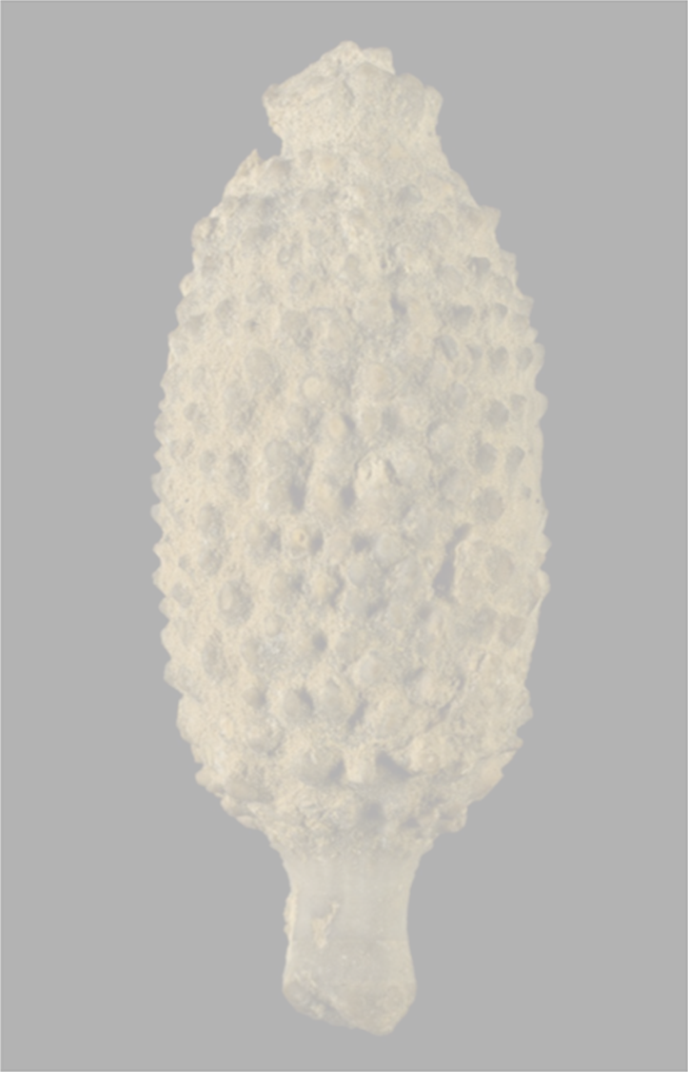
Questions?
Left: Goniocidaris noetlingi
Right: Balanocidaris gibberula
MNHN, Chagnoux, 2024

